Slide 1
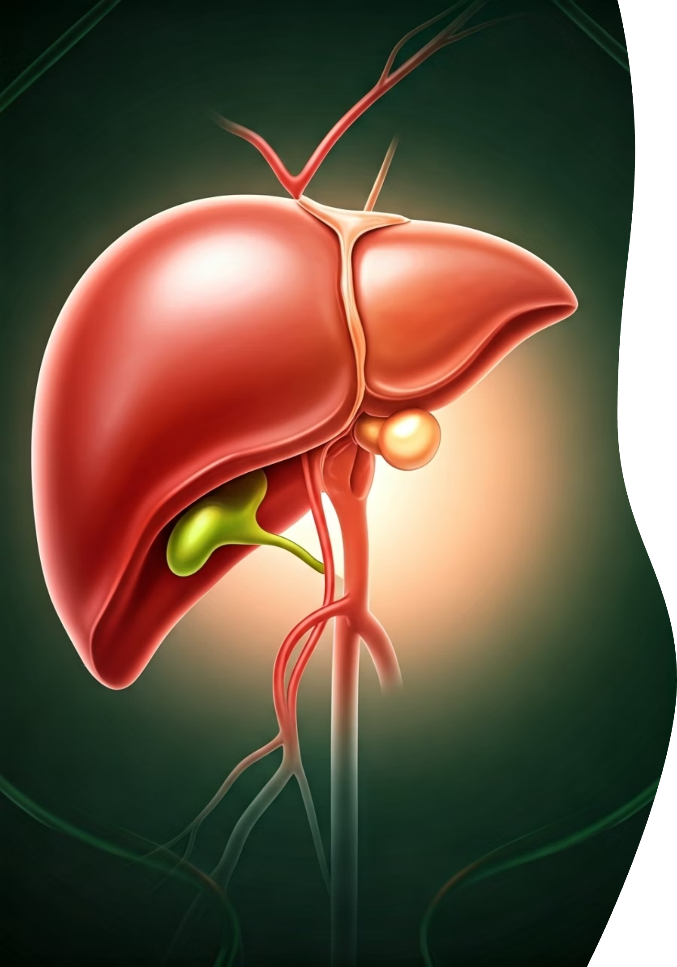

Liver Biopsy – Explained for Beginners
What is a Liver Biopsy?
A liver biopsy is a medical test where a small piece of your liver is taken out and looked at under a microscope. It helps doctors find out what is wrong with your liver.
by Ram N Java

Slide 2
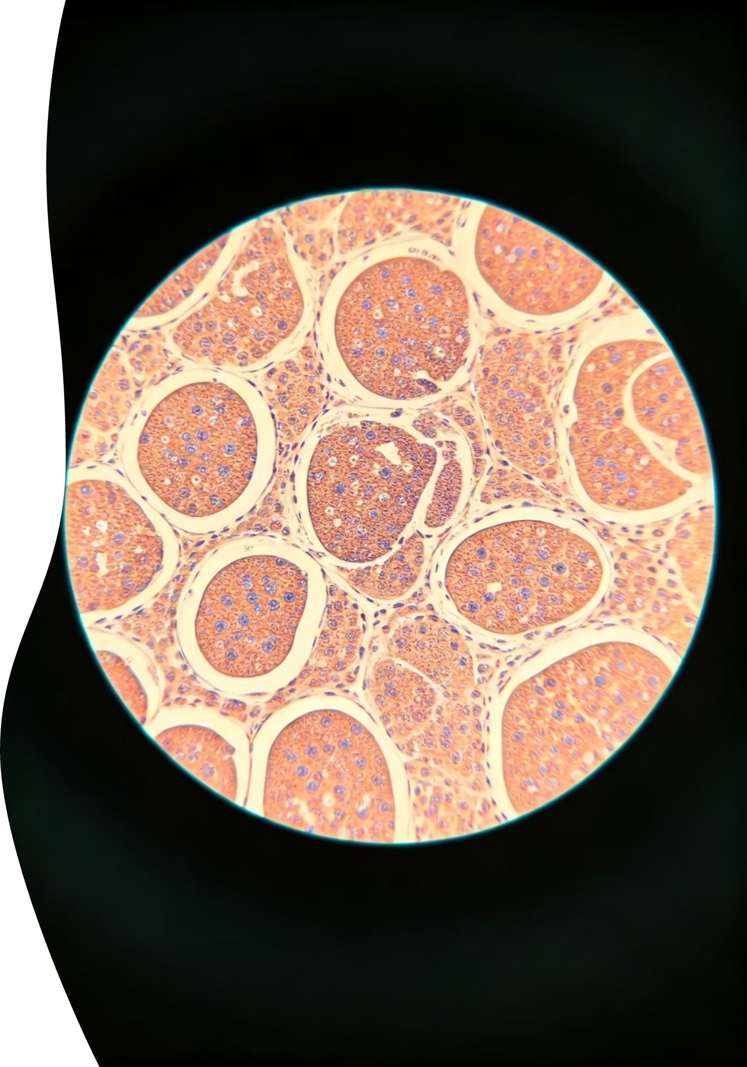
Why is a Liver Biopsy done?
Check for Liver Diseases
Doctors use liver biopsies to check for liver diseases like fatty liver, hepatitis, or cirrhosis
Assess Damage
To see how much damage is in the liver
Treatment Planning
Help decide the best treatment for liver conditions
Monitor Progress
Check if a treatment is working

Slide 3
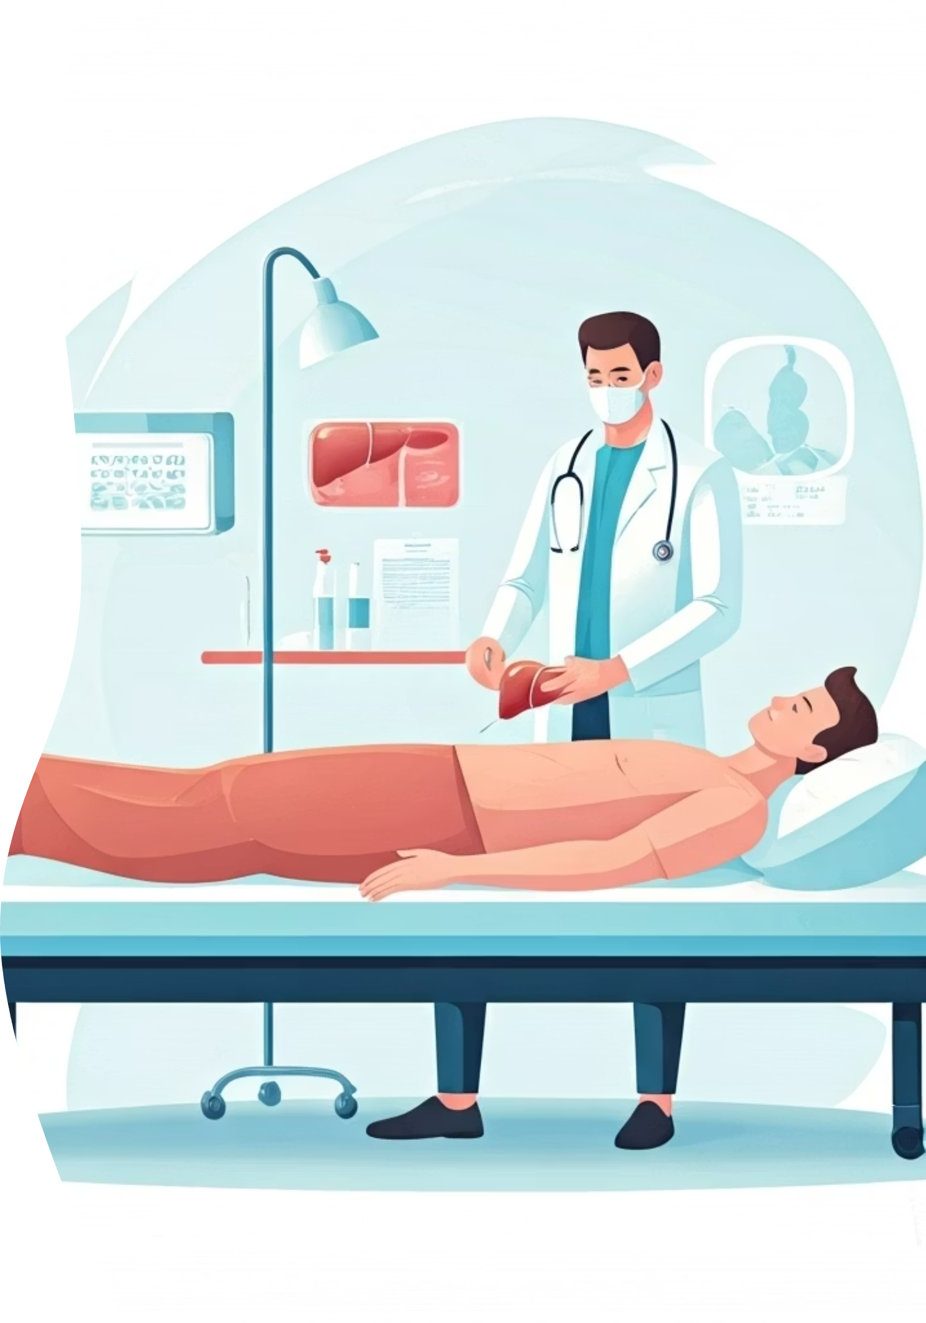
How is it done?
Patient Position
You lie on a bed.
Preparation
The doctor cleans the skin over your liver (right side of your belly).
Anesthesia
You may get a numbing injection to avoid pain.
Sample Collection
A thin needle is quickly inserted to take a small liver sample.
Completion
The needle is removed and the area is covered with a bandage.

Slide 4
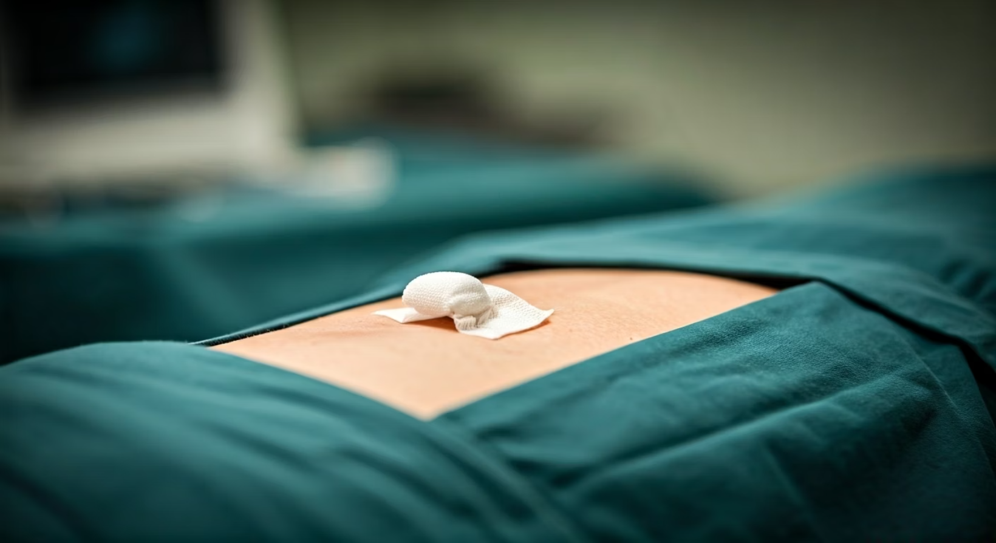
Does it hurt? How long does it take?
Pain Level
Time Required
You may feel a little pressure or sting, but not much pain. You might feel sore for a few hours afterward.
The procedure itself takes only 5 to 10 minutes, but you may need to rest for a few hours afterward.
Procedure
1
5-10 minutes for the actual biopsy
2
Recovery
Few hours of rest after the procedure

Slide 5
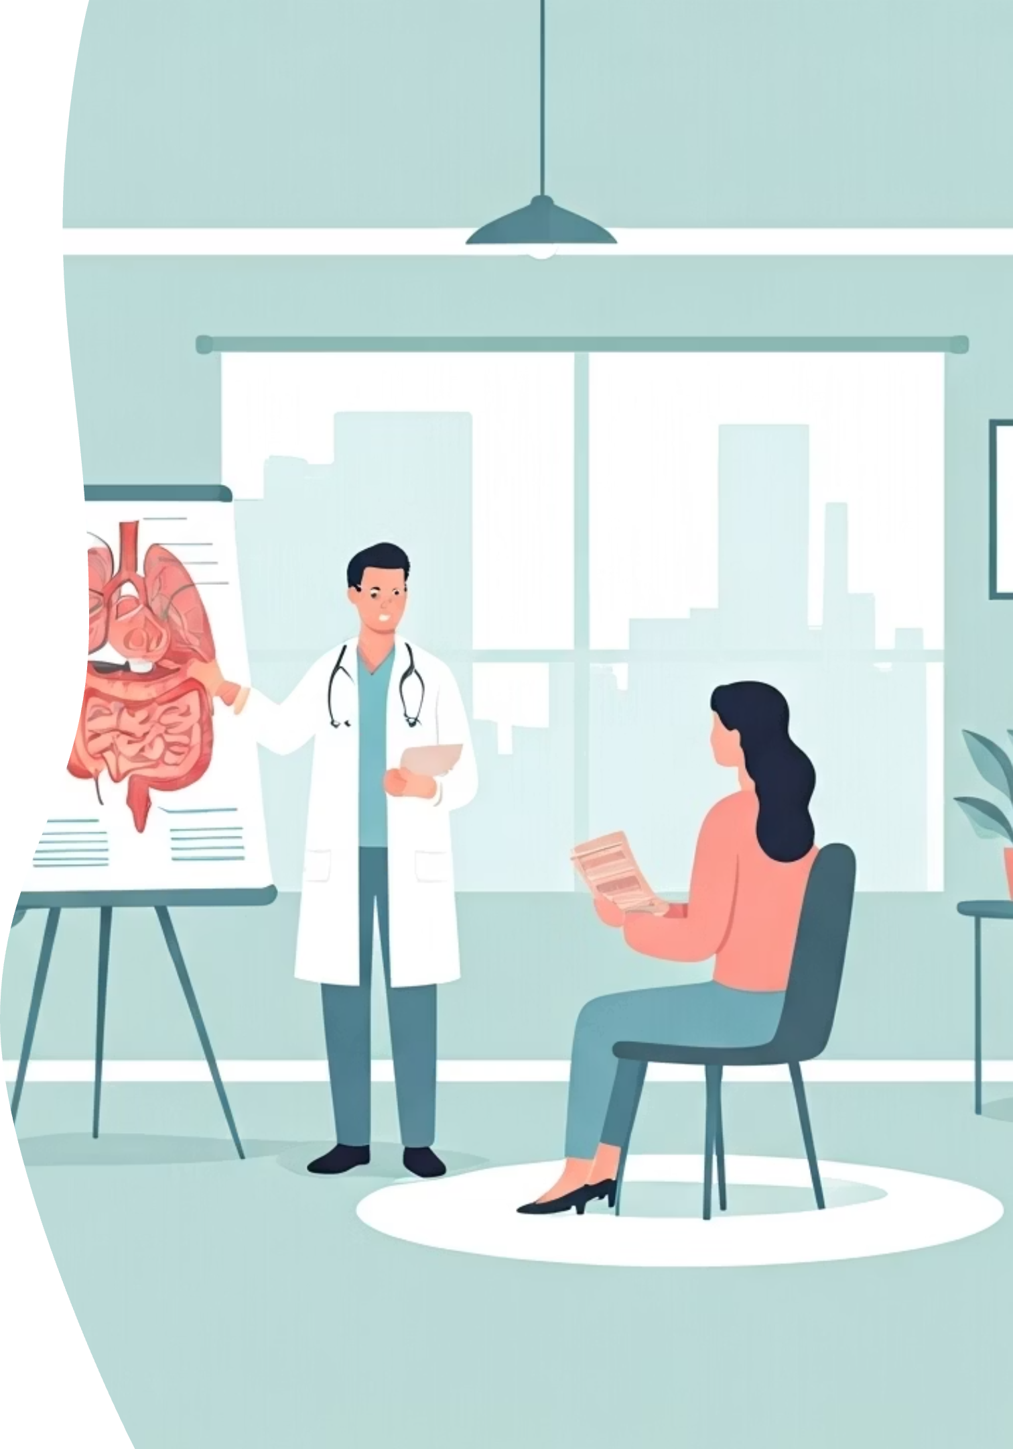
How to prepare?
Before the Procedure
After the biopsy
You may be told not to eat or drink for a few hours before the test.
You will rest in the clinic or hospital for a few hours.
Avoid heavy work or exercise for 1–2 days.
Tell your doctor about any medicines or health problems you have.
Follow your doctor's instructions.
Someone should come with you, as you may need help going home.

Slide 6
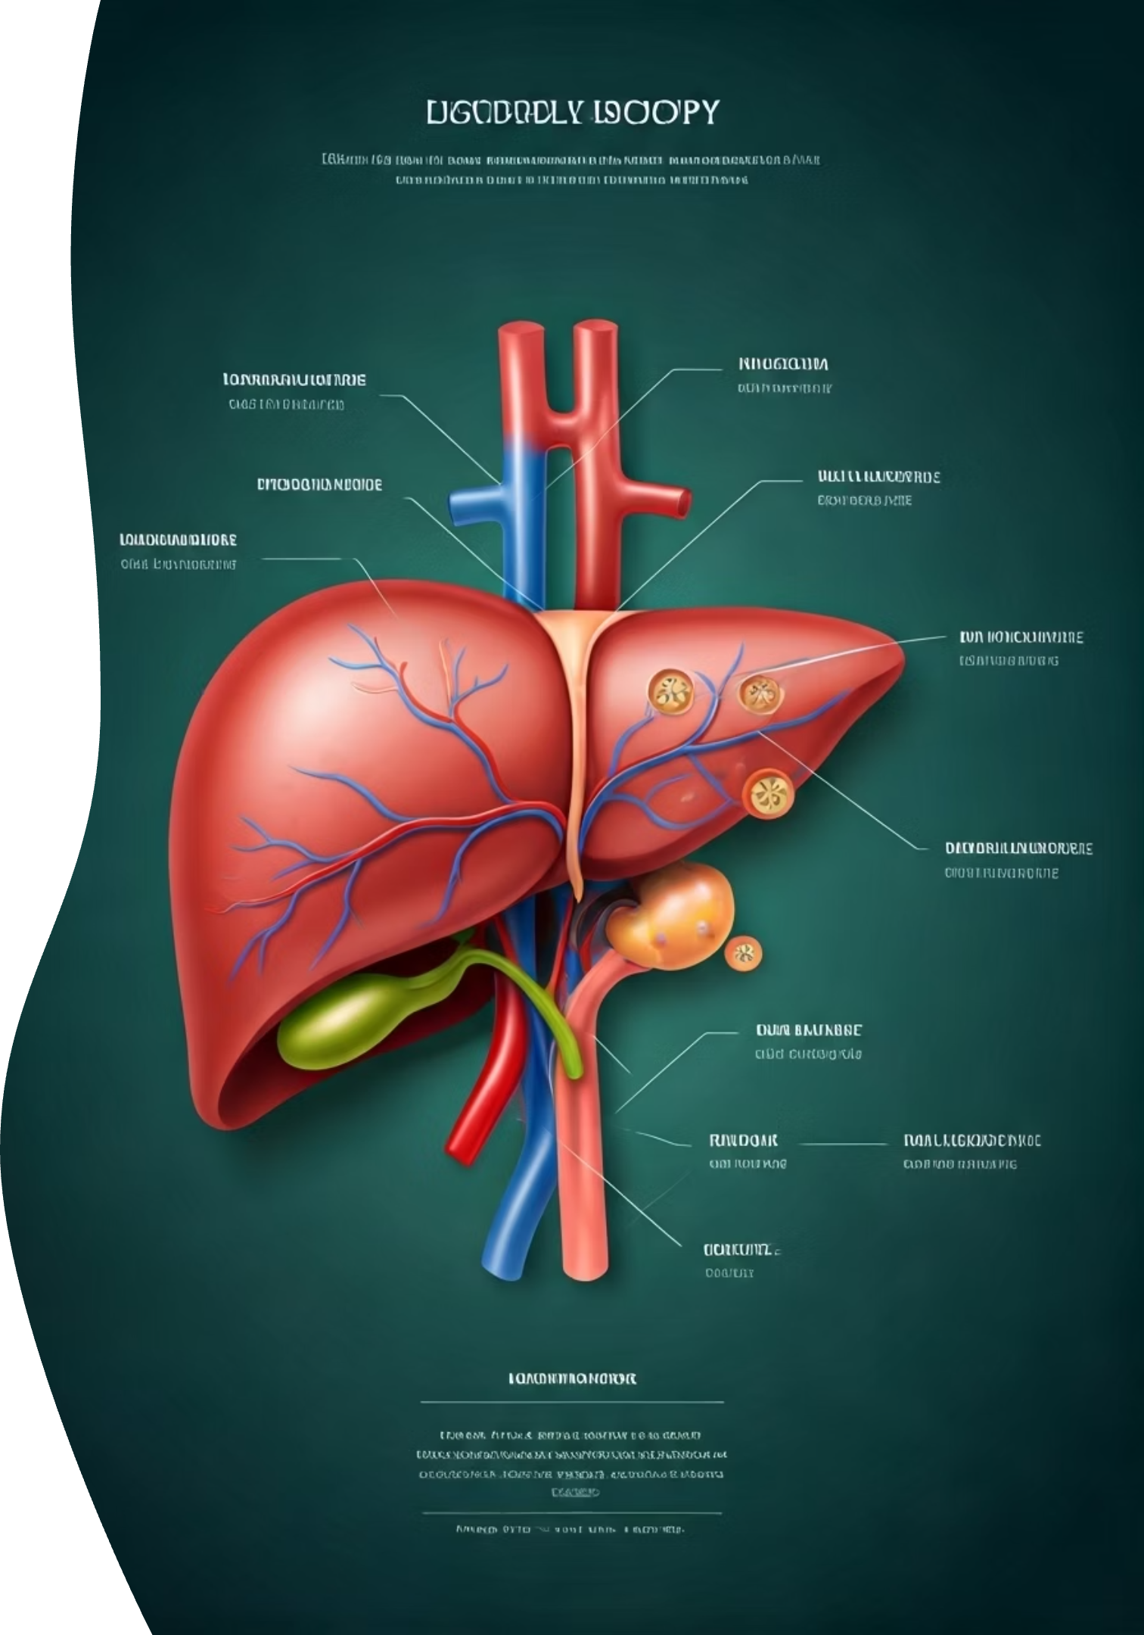



Are there any risks?
Liver biopsy is usually safe, but in rare cases it may cause:
Bleeding
In rare cases, the biopsy site may bleed more than expected. Medical staff monitor for this complication.
Pain
Some patients experience discomfort or pain after the procedure, which can usually be managed with medication.
Infection
Though uncommon, infection at the biopsy site is possible. Sterile techniques are used to minimize this risk.
Your doctor will explain how these risks are managed.

Slide 7
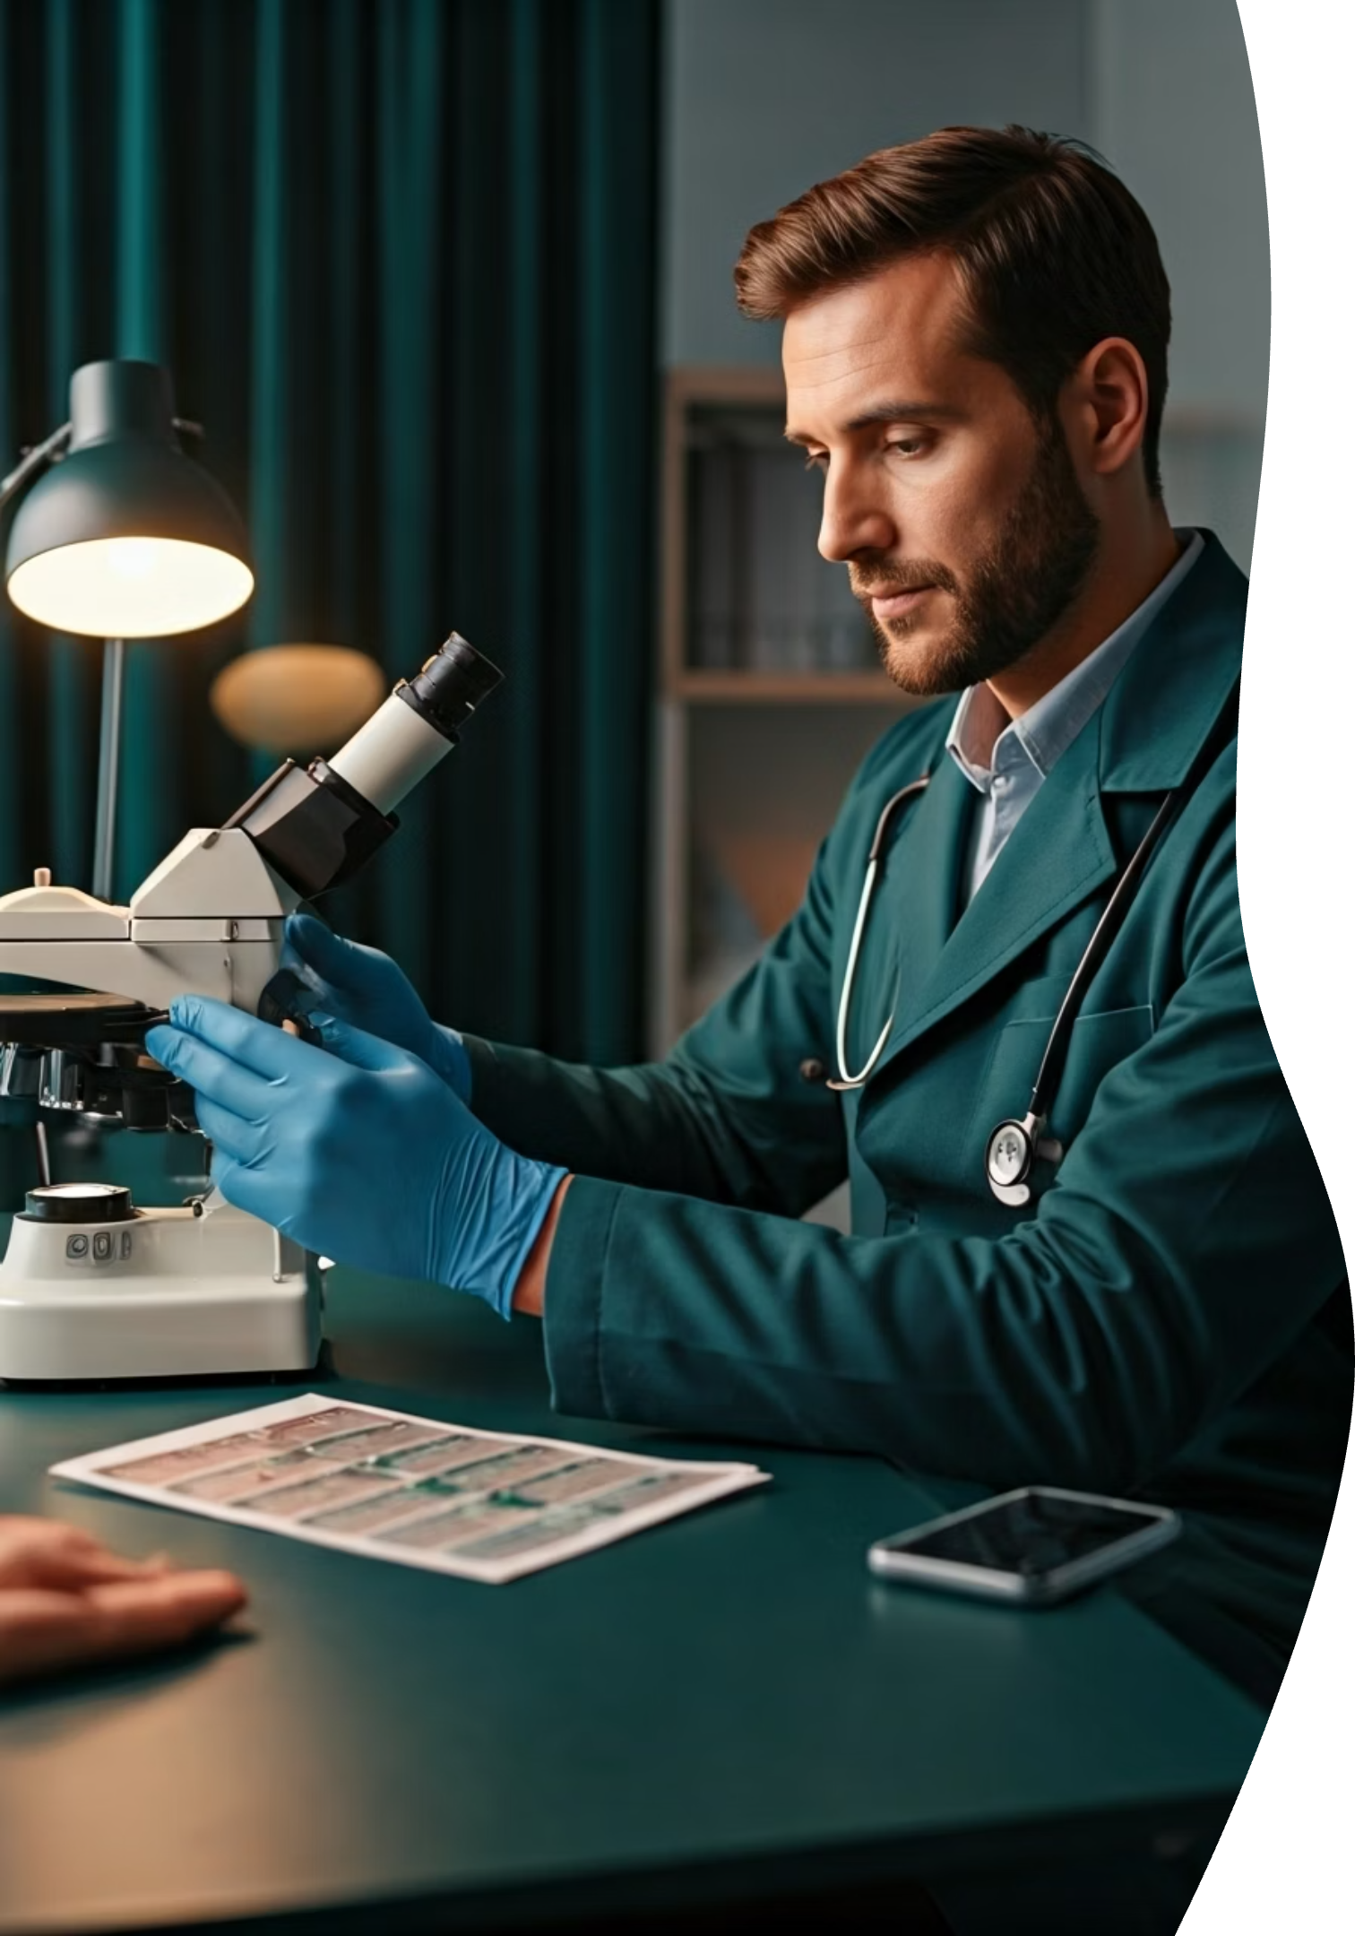



Why is it important?
A liver biopsy gives the doctor a clear view of your liver's health, which helps in:
Treatment Planning
Finding the right treatment based on accurate diagnosis
Disease Staging
Checking disease stage to understand severity
Progress Monitoring
Tracking progress over time to evaluate treatment effectiveness

